Slide 1

How serious is your Hepatitis?
Dawayne Eason
Linh Nguyen
Geoff King
Haroon Ahmad
Raaghavan Krishnamurthy

Slide 2


Background
What is Hepatitis?
Frankly: Disease of the liver
From the CDC:
“Many people with hepatitis do not have symptoms and do not know they are infected. If symptoms occur with an acute infection, they can appear anytime from 2 weeks to 6 months after exposure. Symptoms of chronic viral hepatitis can take decades to develop.”
Common Symptoms Include: fever, fatigue, loss of appetite, nausea, vomiting, abdominal pain, dark urine, grey-colored stools, joint pain, and jaundice.

Slide 3
The Motivation!
Questions, that lead us to the research
How ML can help diagnose hepatitis in Advance?
What about a tool, which helps doctor to take care of the prediction, before taking next action?
Data-Driven Treatment of Hepatitis?

Slide 4
The Data Set
The fuel to our analysis and model
Openml.org
Data Points
Data Donated by
https://www.openml.org/d/269
1 Million
Carnegie Mellon University
Categorical
(15)
Continuous
(4)
Classifier
(1)
Definition
Data
Feature Variables
Output

Slide 5




Process Pipeline
The Analysis Flow, for the final output
Interactive Viz
ML Algorithm
SVM
Tabpy
1 Layer NN
2 Layer DNN
Random Forest
< 92% Accuracy
+93% Accuracy

Slide 6
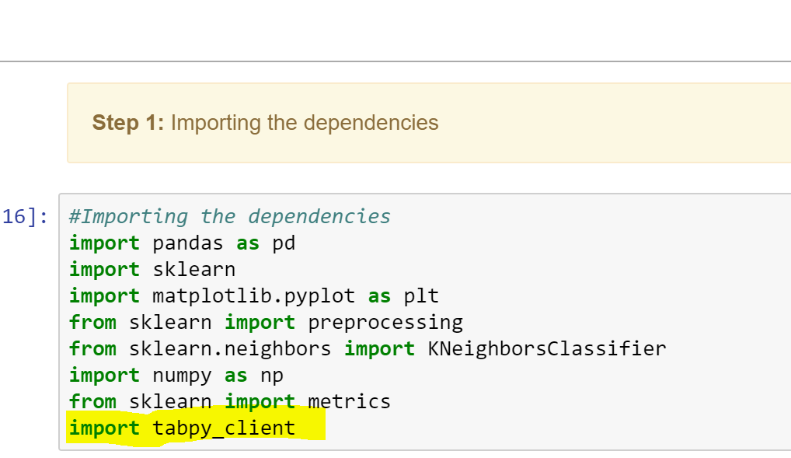
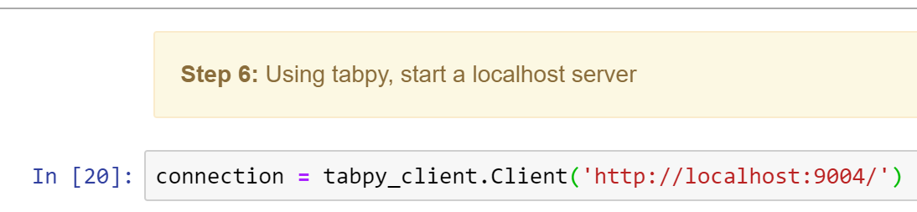
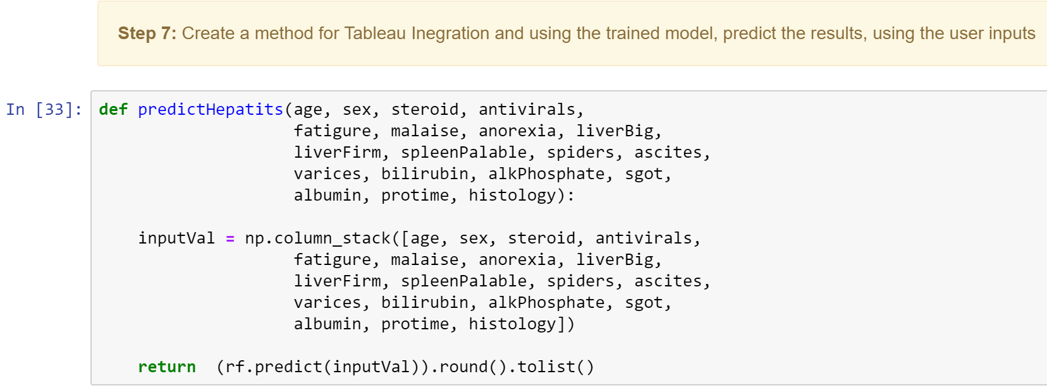
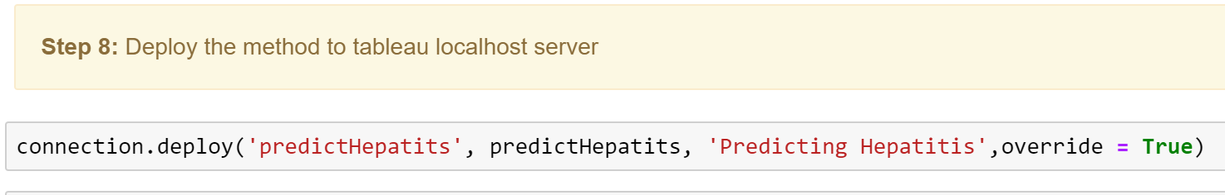
Integration provided by Tableau for Python ( using localhost server)
You can use a calculated field and call Python Code in it
You can also have your code in jupyter notebook or .py and invoke the method.
Deploy the code in localhost server
Interactive Viz
ML Algorithm
SVM
Tabpy
1 Layer NN
2 Layer DNN
Random Forest
< 92% Accuracy
+93% Accuracy

Slide 7
Implications and Findings
Will this tool magically cure all Hepatitis cases?
Could this tool help doctors (Witch Doctors included) to identify Hepatitis?
Could this tool be developed further to help patients identify their risk?

